Slide 1


Slide 2

Agenda

Slide 3

Agenda
Artificial Intelligence (AI) has played a significant role in SARS-CoV-2 detection and prevention since the onset of the COVID-19 pandemic. Review the user history feature's requirements and objectives. Discuss the need for X-ray uploads with associated names.
AI algorithms can process large volumes of data quickly, enabling rapid analysis of COVID-19-related information, such as patient data AI can provide highly accurate results. AI solutions can scale easily to handle large datasets and adapt to evolving situations.
SARS Covid-19 has been developed to assist in identifying COVID-19 cases quickly and accurately. AI has proven to be a valuable tool in SARS-CoV-2 detection and prevention, offering speed, accuracy, and scalability.
These AI applications have the potential to enhance our ability to respond effectively to the ongoing COVID-19 pandemic and future infectious disease outbreaks.
Data collection and preprocessing for AI-based SARS-CoV-2 detection are vital but come with significant challenges related to data availability, privacy, and quality. Overcoming these challenges requires a multi-faceted approach involving collaboration, technology, and ethical considerations to ensure the responsible and effective use of data in pandemic response efforts.

Slide 4
Project Description
Project Name: | SARS Covid-19 detection through AI
Team: | Mission Possible
Project description: | For users Who want to know their feedback on covid-19 reports the let it free Is a web app That checks users reports and provides the accurate result Unlike if users not able to go hospitals in the covid-19 situation Our application will help them to submit their reports and they can get their accurate result. Based on their result they can order the medical kit and they can make an appointment to the doctors as well.
Benefits outcomes: | It the users can use our application they can easily get their covid-19 accurate feedback. Based on that they can order the tool kit and they can take the precautions s well.
github link: | https://github.com/htmw/2023S-Team4/wiki

Slide 5
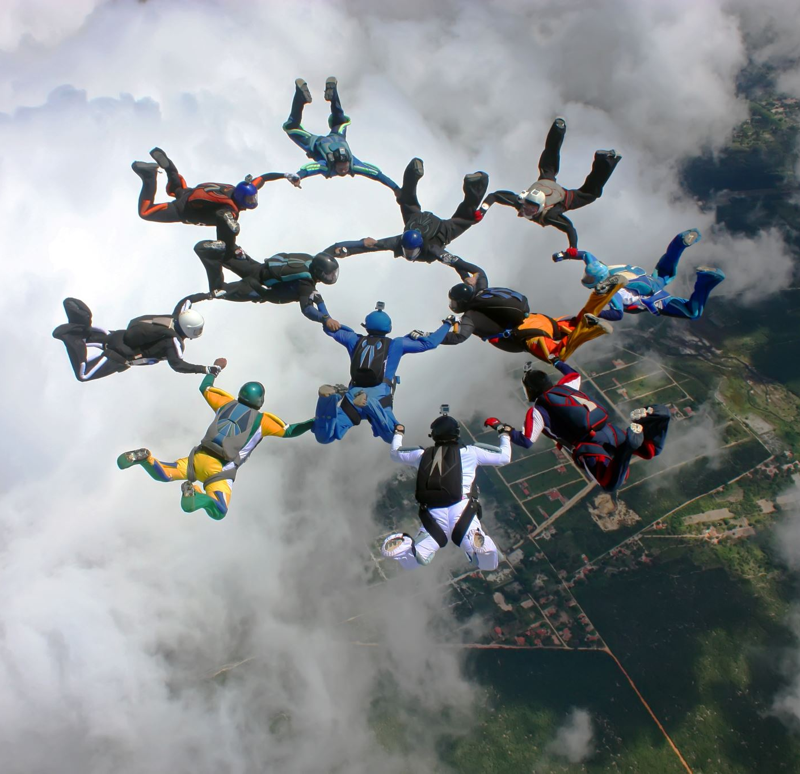
Team working agreement
We held a Zoom meeting on Sunday’s during which we discussed Sprint-5 and allocated tasks to each team member.
Every team member is expected to be prepared with their assigned tasks completed within the agreed-upon deadlines.
To ensure that everyone is well-informed about their roles and responsibilities and comfortable in fulfilling them.
We've set clear expectations for task completion and established specific deadlines.

Slide 6

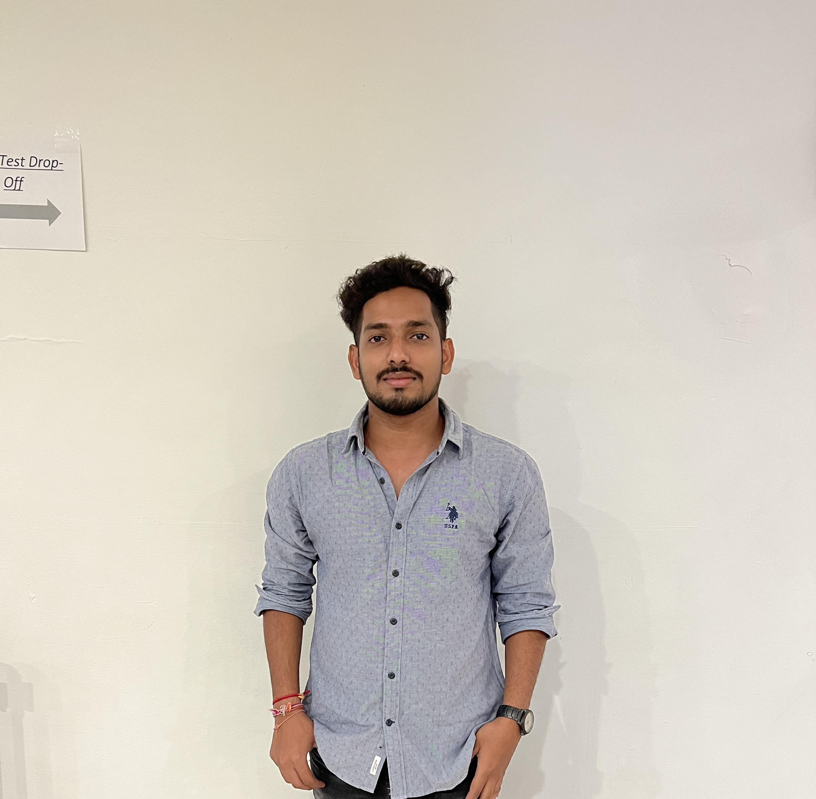

Team Member Roles and Responsibilities
Hanith atluri
(Tester)
Vamshi
(Product manager)
Alekhya
(Facilator)

Slide 7
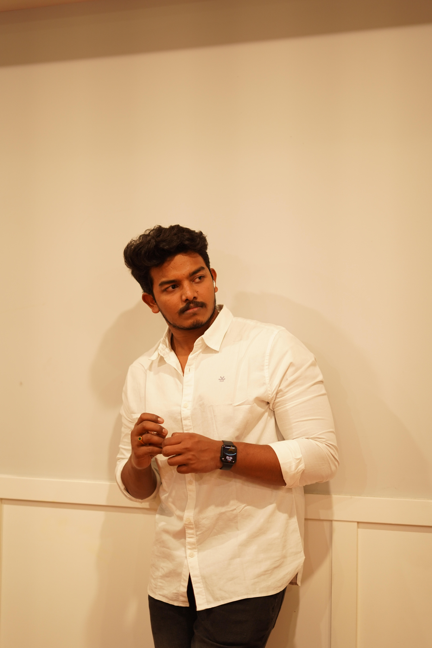

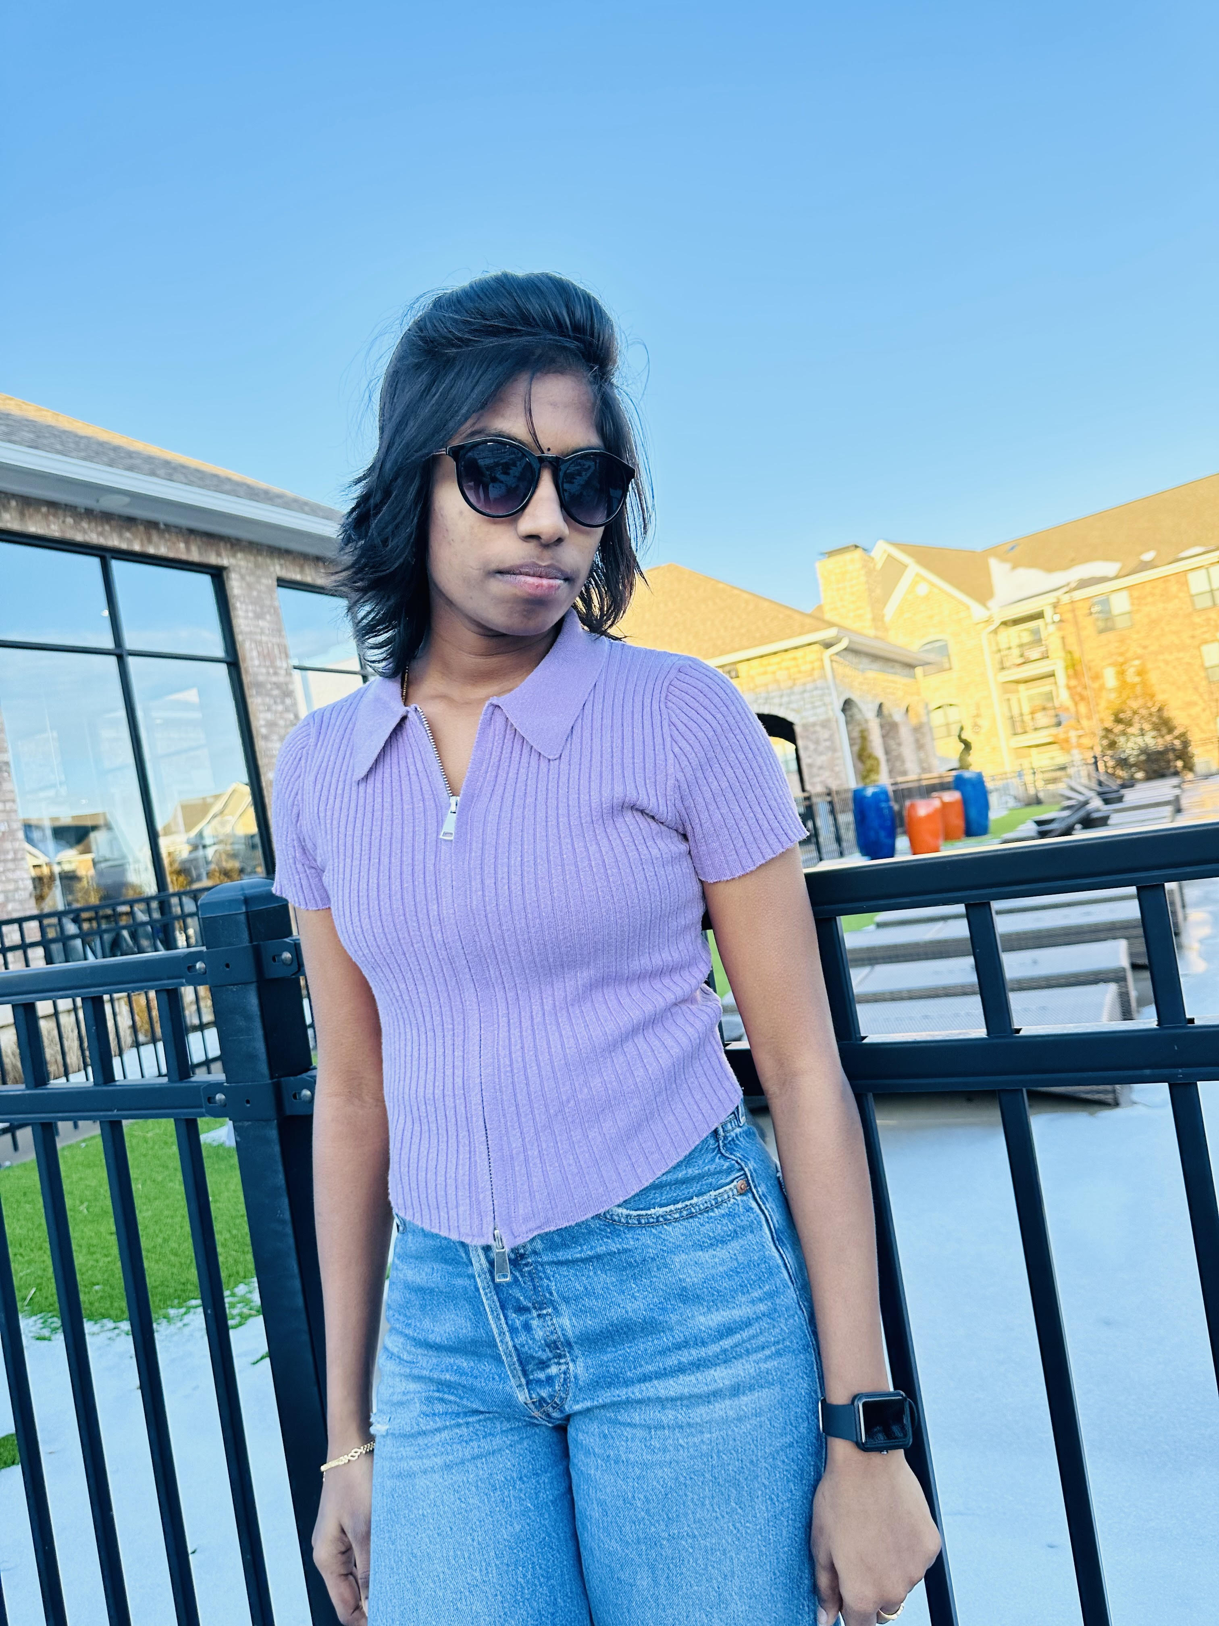
Team Member Roles and Responsibilities
Venkatesh
(Quality Analyst)
Reshma Gonu
(Developer)
Anusha Nunna
(Developer)

Slide 8
Improvements made from Professor Feedback
The team chose not to incorporate the most recent feedback offered by the professor.
This time, in response to the professor's feedback, we have created tables for stories not completed.
In the upcoming Sprint, it's imperative that you present a demo of your Minimum Viable Product (MVP) that goes beyond just showcasing the login and signup features, are not sufficient.
We conducted a demo for the user history feature, allowing the storage of multiple results under one profile, and we have received feedback. For this deliverable, our intention is to integrate further enhancements in response to this feedback.
Updated Technical Paper
This time, all team members collaborated on the technical paper.
The tasks and user stories for Sprint 3 are missing, along with their corresponding Burndown Chart.
→ We need to address the absence of Sprint 3 tasks, user stories, and their associated Burndown Chart.

Slide 9
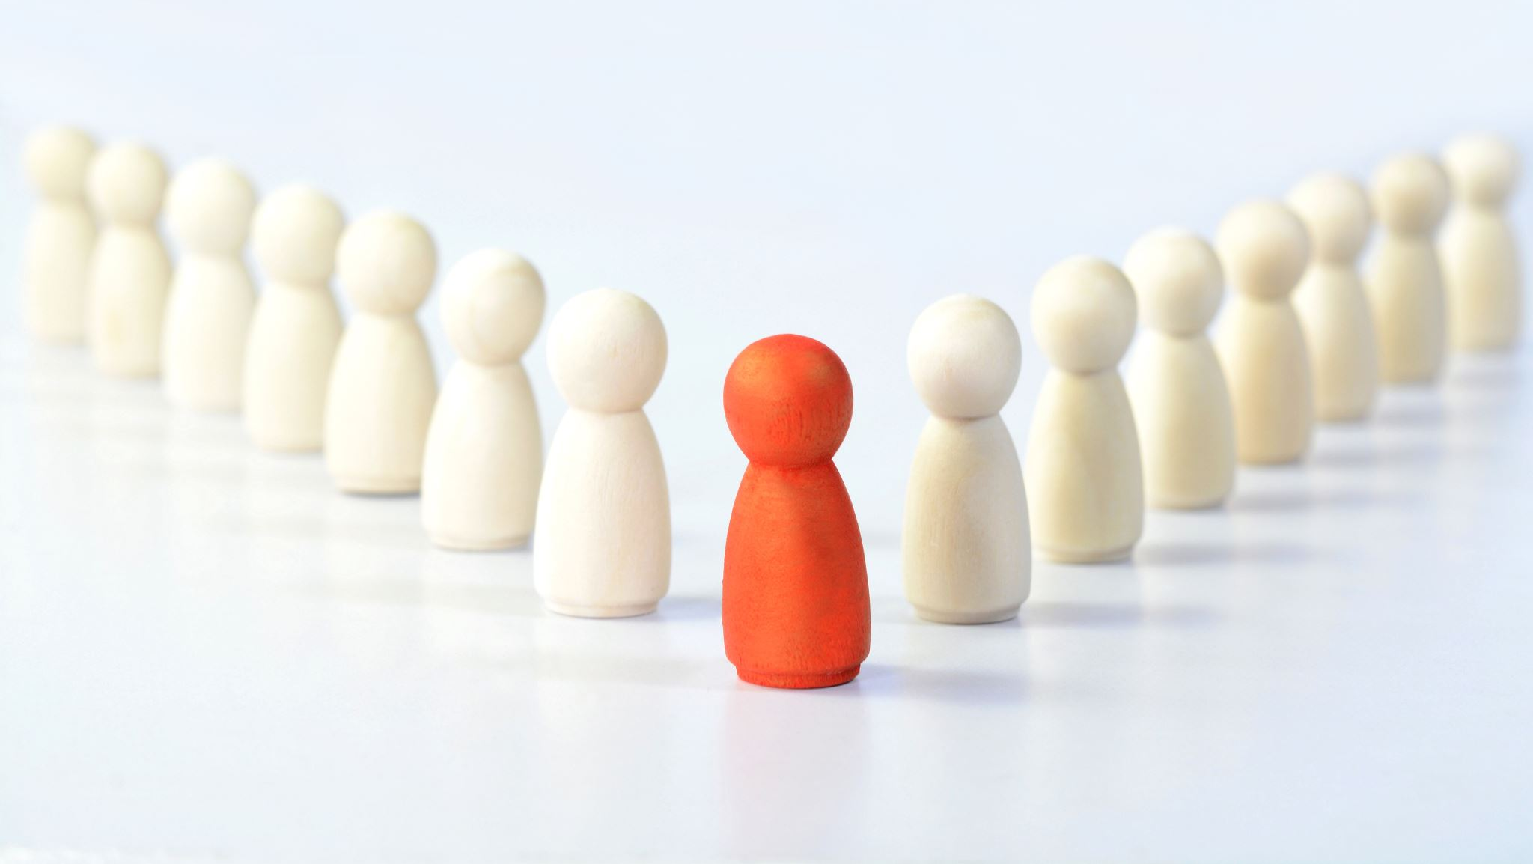
Personas

Slide 10
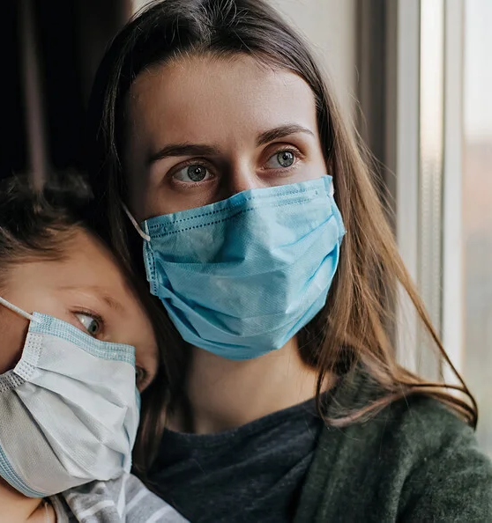
Persona-1
Name: SARAH RODRIGUEZ
AGE: 42 YEARS
GENDER: FEMALE
Her daughter recently developed a persistent cough, so she went to hospital with her daughter to get checked out and the doctors wanted to check if her daughter was showing any signs of convulsions.
The X-ray was carried out, but none of the doctors are available to provide the feedback. Sarah needs a platform that allows her to upload her daughter's recent X-ray securely, associating it with her daughter's name, for AI analysis. She is able to do that using SARS COVID 19 DETECTION through AI.

Slide 11
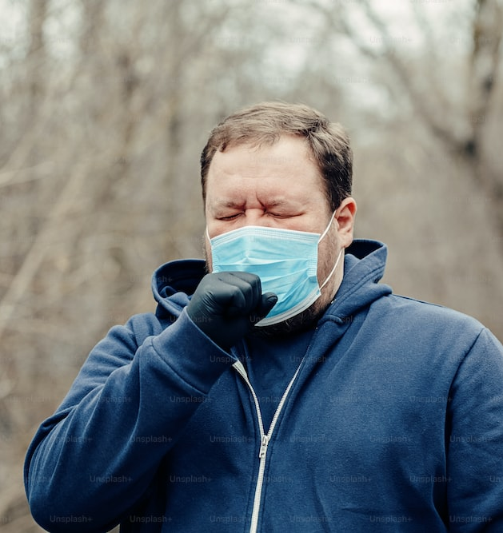
Persona-2
NAME: ALEX
AGE: 35 YEARS
GENDER: MALE
As a parent of two school-going children, Alex is deeply concerned about the family's health, especially during the ongoing COVID-19 pandemic. Being knowledgeable about the advancements in technology, Alex actively seeks convenient and efficient solutions to manage the family's healthcare needs.
Alex wants to save multiple test results under one family profile. Alex wants a seamless experience where all family members' test histories and results can be securely stored and easily accessible whenever needed. This feature allows Alex to monitor the family's health proactively and share the information with healthcare professionals if required.

Slide 12
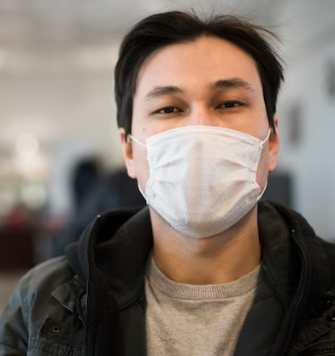
Persona-3
NAME: JAMES
AGE: 26
GENDER: MALE
James is well-informed about the ongoing COVID-19 pandemic and understands the importance of regular testing and monitoring. James lives with his elderly parents, making him particularly cautious about their family's health.
James, concerned about the rising COVID-19 cases in his area, uses SARS COVID 19 DETECTION THROUGH AI to maintain his family's health history. After his father experiences mild symptoms, he logs the details, including symptoms and the subsequent test results, into the application. Over the next few days, James has to take his father for retesting based on his symptoms. When he visits the doctor, James effortlessly shares his father's health history, aiding the diagnosis process.

Slide 13
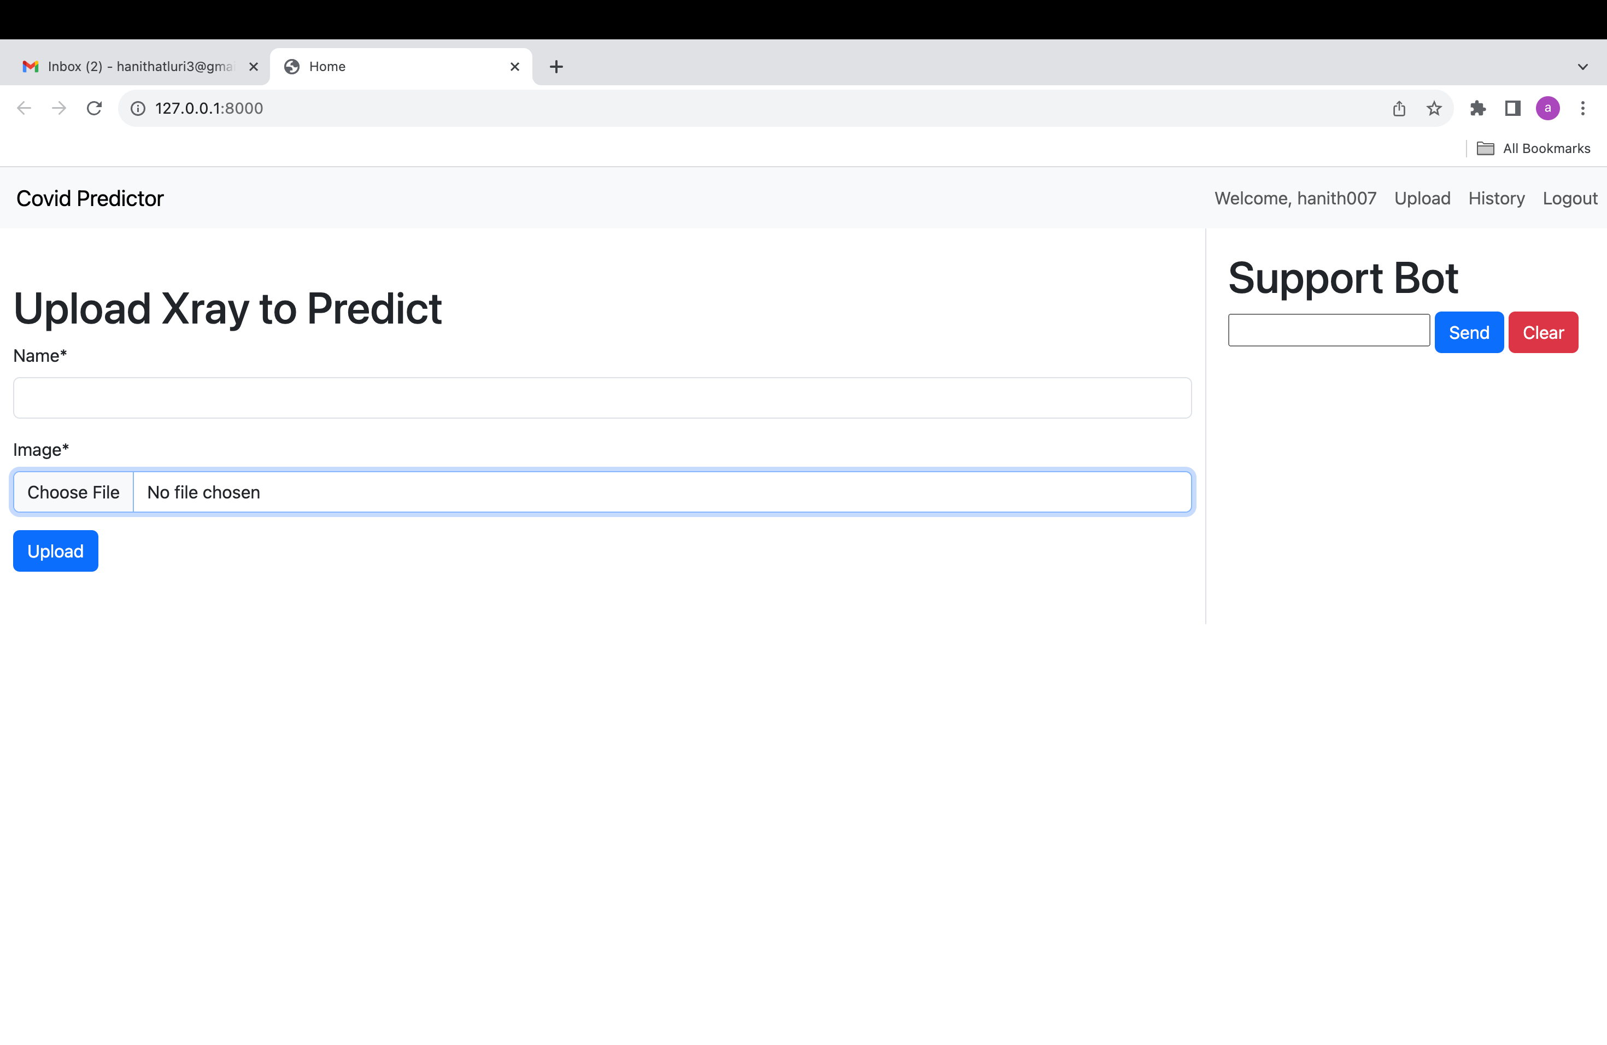
MVP-Minimum viable product
With this project's minimum viable product (MVP), we will be able to upload a CT-scan document from a patient with chronic obstructive pulmonary disease in order to verify the report's current status.

Slide 14





Technology & algorithms

Slide 15
Convolutional Neural Networks (CNNs):
CNNs are able to identify COVID-19 and other medical disorders automatically by learning important features straight from the X-ray pictures. However, the quality and amount of the training data, as well as the network design, can have a significant impact on a CNN's performance. Therefore, it is crucial to conduct extensive validation and assessment prior to use CNNs for medical image processing, particularly in hospital settings.
Convolutional layer
Pooling layer
Convolutional layer
Pooling layer
Fully-connected layer
Output/prediction
Input

Slide 16
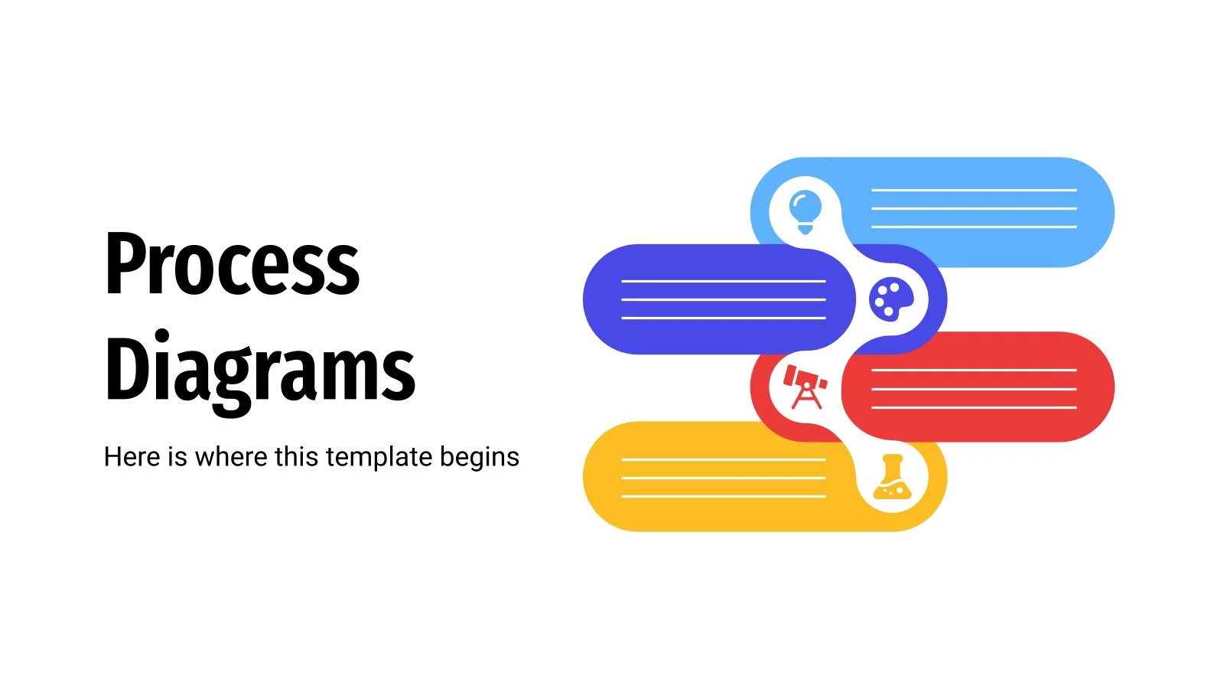

Slide 17
Conceptual Architecture Diagram
Image
Local storage
Load the image from local storage
system
Result displayed on screen
Backend server
Result sent to the App
Process the image
Evaluate the image with pretrained model
Firebase Database
Result stored in Database

Slide 18
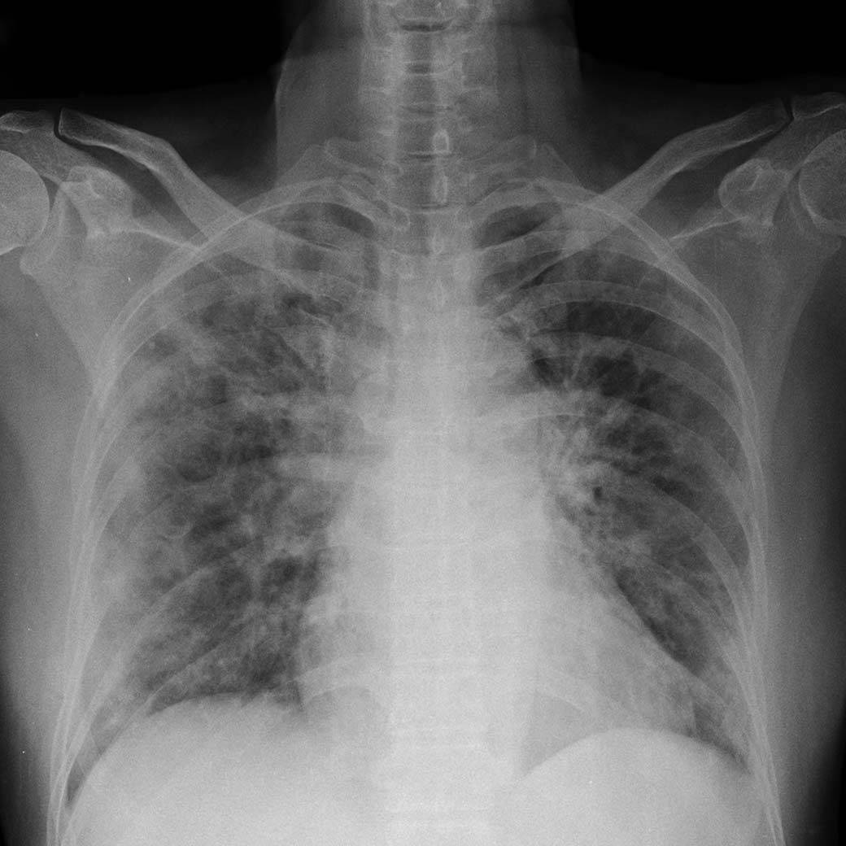
Class Diagram(UML Diagram)
Image preprocessing
Data Augmentation
Pre-trained CNN models
Normal
Proposed CNN Model
New fully connected layers
Covid-19

Slide 19


Slide 20
Recap of sprint-4
Implemented X-ray report upload feature for COVID-19 evaluation.
Introduced chatbot for discussing various health issues.
Defined core MVP features aligned with project goals.
Made progress in the deployment phase, addressing challenges.
Developed a technical paper, covering its purpose, scope, and key findings.
Shared team metrics and relevant KPIs.
Listed incomplete tasks and outlined plans for resolution.
Reported the percentage of test cases covered during the sprint
Summarized key take aways and action items from the retrospective.

Slide 21
Team velocity(Sprint-05)

Slide 22
Team’s average velocity

Slide 23
Burndown chart

Slide 24
Retropective
WELL DONE THINGS- We've improved our deliverable by including additional amenities and ensuring that they all function properly. The success of our group effort may be attributed in large part to the open lines of communication we maintained throughout. When it comes to the construction process as a whole.
WHAT NEEDS TO BE CHANGED- We plan to use the professor's comments to refine our work. The group needs to work on its lack of teamwork. Meetings should focus more on brainstorming potential project directions.
WHAT MEASURABLE STEPS WE MADE TO DEVELOP- There must be more honesty and openness in our interactions. Additional conversations are required. We're going to have a more in-depth conversation about potential projects in order to refine our software.

Slide 25
Completed/Committed ratio
Changed the IDE to PyCharm from Android Studio.
Multiple results can be saved in a single profile.
User activity log
Conversational UI and user training
Database update
Put up a CT-scan and label it with your name
User dashboard development and implementation
Technical Report Revised

Slide 26
Product Backlog
SARS-258 SARS-260 SARS-261 SARS-263 SARS-264 SARS-265 SARS-266 | user stories summary As a user , I want to update the information in the portal. So that I can keep my portal active through user login and password Implement a user-friendly search feature with predictive suggestions to help users find content or products more easily. As user , I want to login in portal. Therefore I can all information through portal As user , I want to view my portal and their result As a user, I wish for the portal to continuously monitor my results, providing updates on the progression of my condition, especially when it worsens. As a user, I desire to have the ability to identify diseases that can be diagnosed and treated using X-rays for better healthcare insights. As a user, I aim for a seamless process to input and provide my personal information. | Place Homepage

Slide 27
Sprint 5 backlog
Keys SCRAS-70 SCRAS-72 SCRAS-73 SCARS-74 | Name As an user, I can chat with the chatbot in order to get some random information As an user, I want to receive a report indicating whether they have tested positive or negative As an user, I want to do regular checkup checklist , so that I can get the graphical analysis on my health reports As a user, I want to know my health status through the collection and interpretation of health data by monitoring and analysis of my reports

Slide 28
Acceptance criteria
Scenario | summary | status
1. User get to know about the disease Given I logged as an user 2.As a user I can chat with bot and even login as an individual user so, I can upload the xray and predict the outputs. | As a user I want to know the details about the xray So that I can have the appointment these days As a user I want to know my reports result So that I can view my reports to the doctor on time | done done

Slide 29
Acceptance criteria
Scenario | Summary | status
3. User want to upload the reports in portal Given I logged in as user. When I given the health report to the bot and give is drug usage and specifications 4. User needs to check confirm disease by providing symptoms Given I logged in as user When I logged in and open bot Then I need an interface where I can provide my symptoms and get confirmation | As a user I need suggestions to choose required drug to cure myself so that I can cure my self As a user I can able to check my symptoms by providing inputs so that I can be sure of my health | done done

Slide 30
Test Cases
Test id | User story | Test case | Current state | Steps to follow | Expected result | result
TS-51 | SCIDTA-223 | User logged into the portal | User details (login details) | Login->bot | User should be able to upload the report in the portal | P
TS-52 | SCIDTA-224 | User should able to get the accurate predicted result | User details (login details) Update message | Login->upload->result | User should be able to update the results | p
TS-53 | SCIDTA-225 | User need to I can chat with bot for further updates | User logged into the portal | Login->chat bot | User should able to get a new messages from the bot | P

Slide 31
Completed and not completed stories
key | Name | status
SCARS-50 SCARS-51 SCARS-52 SCARS-53 | Develop the MI model AI on render User results through the AI detection to predict the disease Analysis of report with the previous repoort Updating the user reports to doctor through portal | Done Done Not done Not Done

Slide 32
Thank you!!!

